Slide 1
Customer Experience Self -Assessment & Action Plan
Ms. Dawn Johnson
Mr. Thomas Pasakarnis
Ms. Donna Richardson
Ms. Amanda Tepfer

Slide 2

CX Self-Assessment & CX Action Plan
Why Conduct a CX Self-Assessment
Deep Dive into the CX Self-Assessment
Change Management Refresher
CX Action Plan Template Preview
Conclusion

Slide 3
Federal Government and CX – PMA & A-11
The President’s Management Agenda (PMA) lays out a long-term vision for modernizing the Federal Government in key areas that will ensure that The Federal Government delivers a simple, seamless, and secure customer experience, on par with or more effective than leading consumer experiences.
PMA Priority 2 - Delivering Excellent, Equitable, and Secure Federal Services and Customer Experience
Office of Management Budget (OMB) Circular A-11 is a United States government circular that addresses budget preparation for federal agencies and is the primary document that instructs agencies how to prepare and submit budget requests for OMB review and approval.
OMB has updated A-11 requirements to fulfill PMA’s Priority 2: Implementing the guidance specified in this section will establish a more consistent, comprehensive, robust, and deliberate approach to CX across government.
The core CX functions are included in the CX program maturity model: Measurement; Governance and Strategy; Culture and Organization; Customer Understanding; and Service Design

Slide 4
SES Performance Plan
Another action VA has taken to further the President’s Management Agenda’s Priority 2 Goal is to include a customer experience element in every SES performance plan.
Critical Element | Measure | Scoring for Demonstrated Performance
Excellence in Customer Experience (CX) (Department and OMB Priority) | Select one of the following options. Metrics to be developed by the executive and rating official. VEO or other customer satisfaction admin/staff office data may be used for this requirement. Option #1 Measure - Deliver improved customer experience by collecting and analyzing qualitative and quantitative data on your customer’s experiences, perceptions, and concerns through a robust voice of the customer program. Use customer experience data and insights to develop and implement action plans to improve the experience. L3: Publish an action plan to collect, analyze and use customer experience data for your organization. OR Option #2 Measure – Deliver improved customer experience by collecting and analyzing qualitative and quantitative data on your customer’s experiences, perceptions, and concerns through a robust voice of the customer program. Use Customer experience data and insights to develop and implement action plans to improve the experience. L3: Increase customer experience scores by XX% (% to be determined by rater) or maintain no change if existing satisfaction score is 90% or higher. Note: XX%-please indicate what % | Option #1 Measure: Exceeds Fully Successful: Implement at least 80% of your action plan, including the establishment of a baseline for measuring customer experience to improve service recovery and performance improvement. Outstanding: Implement at least 90% of your action plan to improve service recovery and performance improvement. Develop and publish best practices for action planning that can be leveraged by other offices to act upon customer experience data with measurable improvements. OR if Option 2 was selected Option #2 Measure: Exceeds Fully Successful: Increase customer experience score by XX% (%to be determined by rater) if previous year’s score is lower than 90% satisfaction score. Outstanding: Increase customer experience score by XX% (%to be determined by rater) if previous year’s score is lower than 90% satisfaction score. Develop and publish best practices that can be leveraged by other offices to act upon customer experience data with measurable improvements. Executive’s will provide a brief narrative summary capturing the assumptions used and data drivers for action planning purposes.

Slide 5
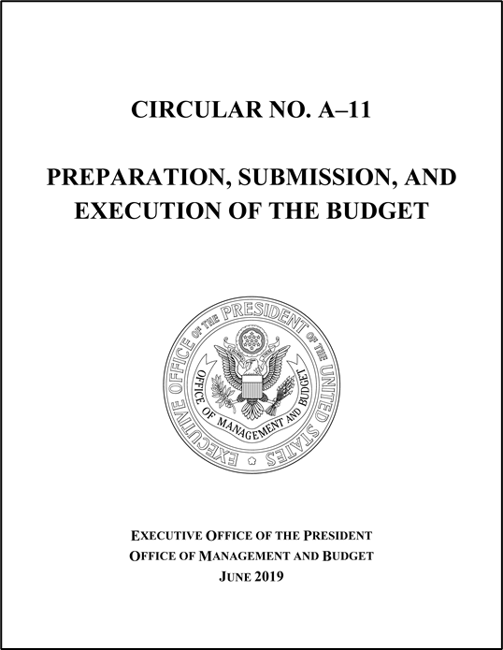
A-11 and HISPs
High-Impact Service Providers (HISP) are those Federal entities designated by OMB that provide the most high impact customer-facing services, either due to a large customer base or a high impact on those served by the program. A HISP is one that interacts with the public to provide a transactional service or perform a regulatory function in which time, money, or information is used to receive a good, service, or authorization. HISPs will be reviewed and updated periodically by OMB. VHA and VBA are VA’s designated HISPs.
HISP Requirements
Collect customer feedback for each of the indicators developed (such as wait times);
Submit data dashboards to OMB quarterly, until feedback data is provided directly to Performance.gov;
Conduct an annual CX Self-Assessment (submitted to OMB) and
Create a CX Action Plan (submitted to OMB) annually;
Begin to embed more customer-focused practices into their service design and delivery such as conducting customer research through qualitative and quantitative research and journey mapping, and continually user-testing program elements with customers to refine and improve.

Slide 6
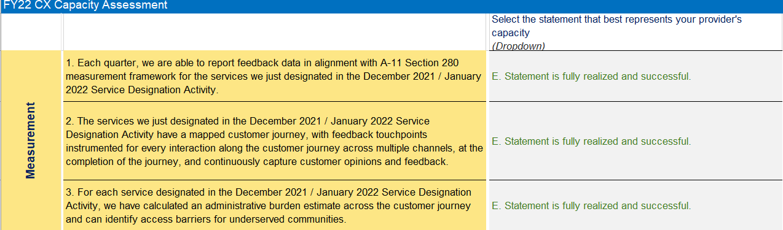
HISP CX Capacity Assessment
One requirement of VHA and VBA as high impact service providers is to conduct a capacity self-assessment.

Slide 7

What is a Self-Assessment/Capacity Assessment?
Self-Assessment is the act or process of analyzing and evaluating oneself or one's actions. (Meriam-Webster Dictionary).
Self-assessment is the evaluation of a work unit’s processes or systems.
Self-assessments are often the first step in a work unit’s journey towards effective outcomes.
The goal of self-assessments is to collect data that can help a work unit evaluate whether or not it is making progress towards various goals.

Slide 8

Why conduct a Self-Assessment?
Conducting a self-assessment helps managers answer essential questions such as “How are we doing?” “What are our strengths?” and “What areas require improvement?”
One of VA’s strategic goals is to build life-long relationships and trust with its customers who are Veterans, their families, their caregivers, and their survivors.
Data from a Self-Assessment will assist managers to determine where to start taking action to improve key outcomes including customer experience outcomes such as Veterans’ trust with VA

Slide 9
CX Self-Assessment Walkthrough
8

Slide 10
Change Management
9

Slide 11
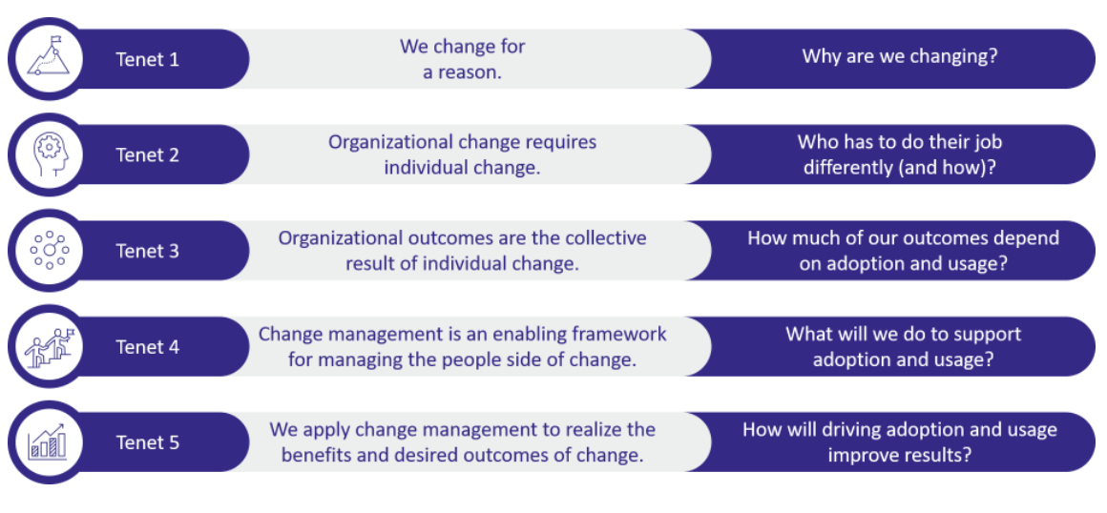
Prosci’s 5 Tenets of Change Management

Slide 12
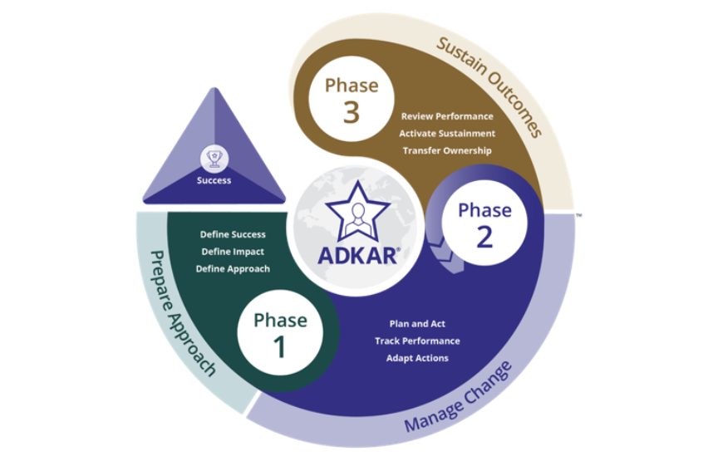
Prosci’s Three Phases to Change Management and ADKAR
People are at the center of change
The success of your action planning depends on everyone implementing the changes
You must start with the end goal in mind
Use ADKAR (Awareness, Desire, Knowledge, Ability, Reinforcement)
Define, Plan, Review
  Define your goal
  Plan your project and measure performance
  Follow-up and evaluate

Slide 13
CX Action Plan
12

Slide 14
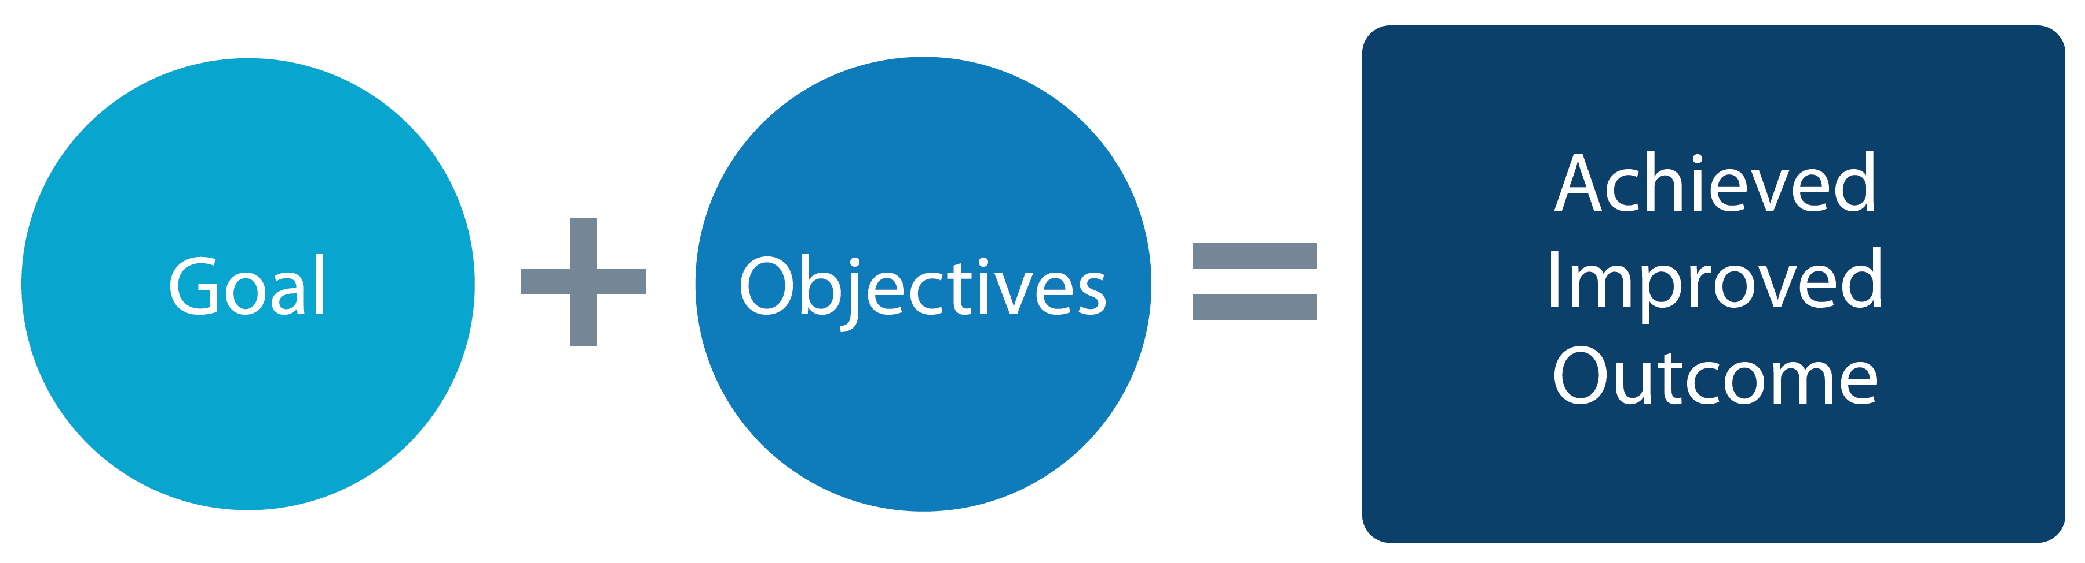
What is a CX Action Plan?
A CX Action Plan is the organizational strategy that identifies the necessary steps to take to achieve a goal. It builds out objective key actions to take, to achieve broader CX Strategic Goals.
GOALS: The outcomes you intend to achieve. OBJECTIVES: The actionable steps you take to achieve an identified goal.

Slide 15

Why develop CX Action Plans?
Prioritizes goals, maximizes resources, and allows for better decision making, increasing organizational efficiency and effectiveness in executing strategies.
Reduces stress affiliated with reaching goals, by breaking down the steps and tasks in a planned and organized manner.
Boosts employee morale and trust, by visually outlining what they will need, to achieve the organization’s strategy, day-to-day.
Allows employees to understand the necessary steps for success and helps them stay motivated and on track to reach goals.
Boosts Veterans trust, by displaying confidence in that efforts are coordinated and purposeful, building credibility and transparency.

Slide 16
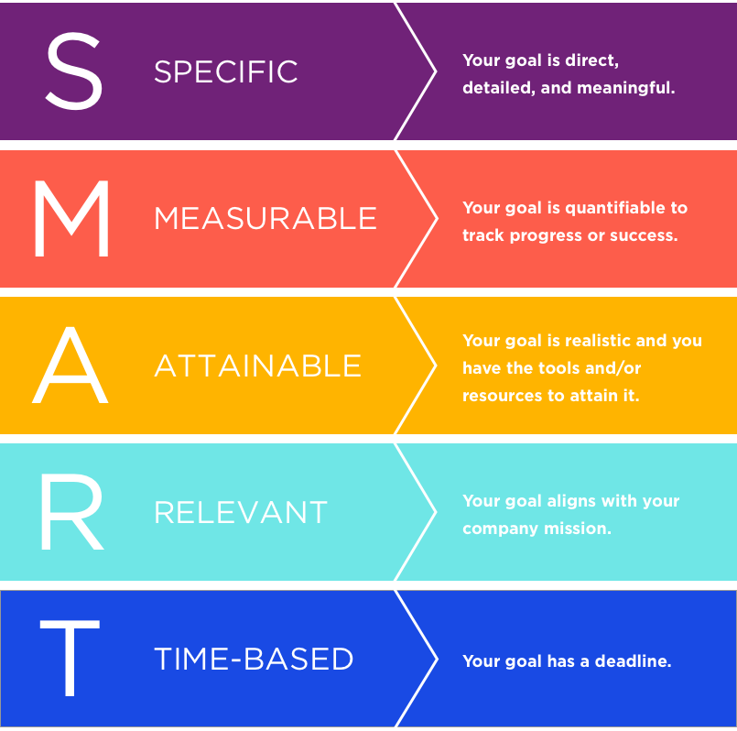
Smart Goals

Slide 17

SMART Goal Example
Weak Goal:
I’m going to get fit.
SMART Goal:
I’m going to build on my current healthy and fit lifestyle now by following the Nike Run Club training program daily, to run the city marathon 6 months from now, without stopping.

Slide 18
CX Action Plan: SMART Goal Development / Quadrant 1
SMART Goal: [INSERT SMART GOAL HERE]
Moments That Matter: Identify which section of the Journey of Veterans map and/or which Moment that Matters from the more specific service Journey Maps that you are targeting for improvement.
Journey Mapping:
VSignals Domain:
CX Cookbook Domain:
Insert Smart Goal Nickname
Lead: Identify the lead that will champion this improvement effort.
Executive / Primary Sponsor: Identify a senior leader to be active and visible in supporting the goal.
Stakeholders: Identify any supporting functions critical to the success of this improvement effort.
Key Performance Indicators (KPI)s:
Identify and baseline the specific customer experience and/or VSignals data that will be used to measure improvements.
Outputs:
Outcome:

